Slide 1
Hardware,
Operating Systems,
Processes,
and Linux
Primitives

Slide 2
TODO!
Might want to split this into 2 sections
More in depth theory
Computer Architecture: Disk (HDD, SSD), RAM, CPU (brain+cache), peripherals: NIC, Mouse, Keyboard, GPU
More into the OS: Processes, PCB, our source of power
Move the layers section to when we talk about systems - and just have a little disclaimer at the start of this one for why we are learning about operating systems - Where does power come from - physics -> hardware -> OS
TODO Better Processes Explanation: https://levelup.gitconnected.com/operating-system-process-management-26c73901166
Notes:
Flow + Terminology
CPU
Fetch Decode Execute Cycle
Main memory
Secondary memory
Operating system
Process
How they work
System Call
Linux
Services, programs, code
Terminal / CLI + Usage
Manpages
Hands on: Process management: Fork, Exec, Wait, Exit

Slide 3
Items Each Process has Access To
Ability to execute code (assembly)
argv, envp
system calls
Process Control
fork, exec, kill, exit, wait, chdir(2)
Information Management
Getpid…
Information Management
And more!

Slide 4
Disclaimer
Notes:
You don’t need to learn this to program and create something good. This is also not an reason not to try to learn everything - You will not be a coding god after this. There is nothing stopping you from just getting started on a project and googling as you go.
I also don’t think you need to directly use C or program at a low level to be a good programmer.
But I do know that spending some time at the lower levels, learning the theory, knowing what is truly available, and being aware of what we take for granted will make you a much better programmer

Slide 5
What is a Computer

Slide 6
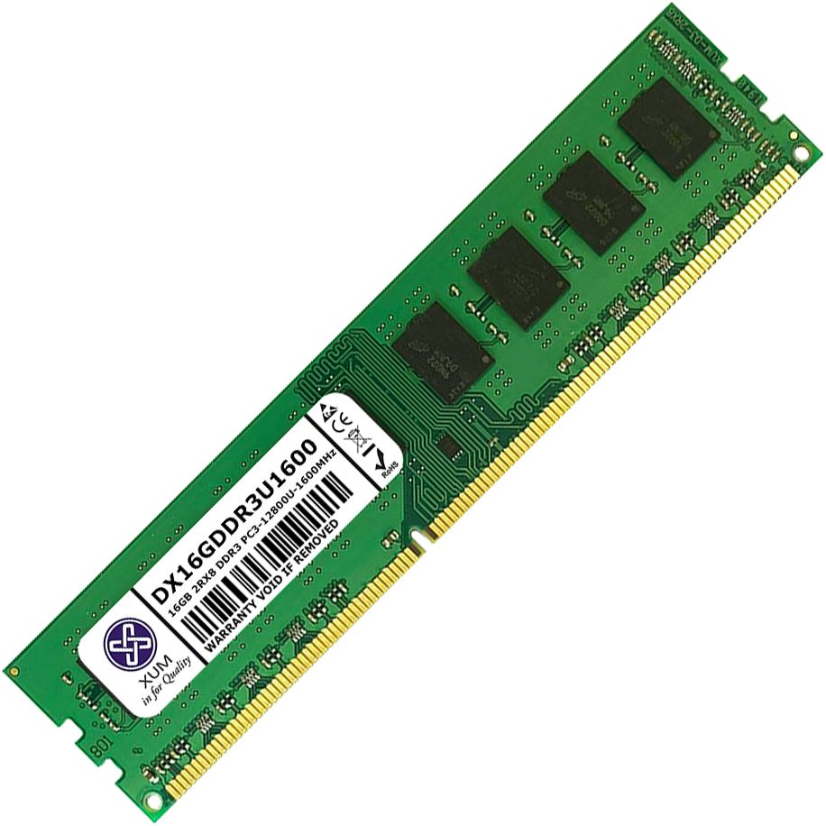
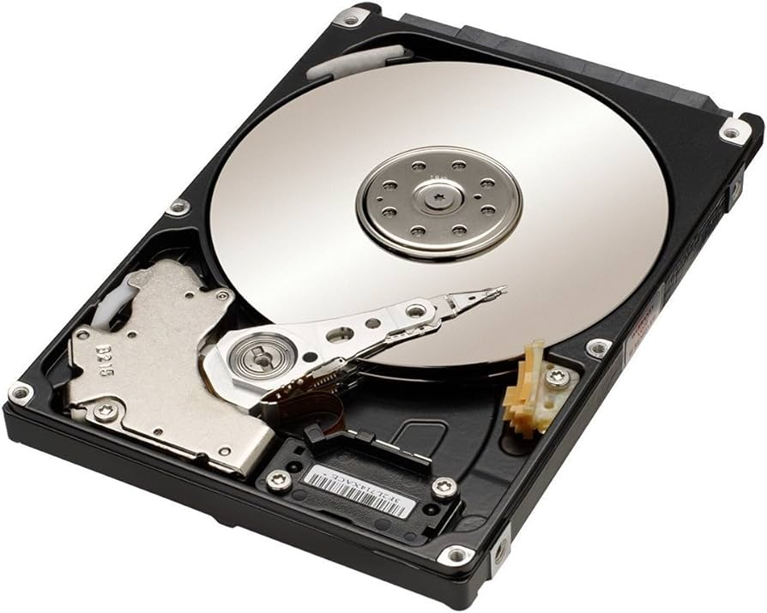
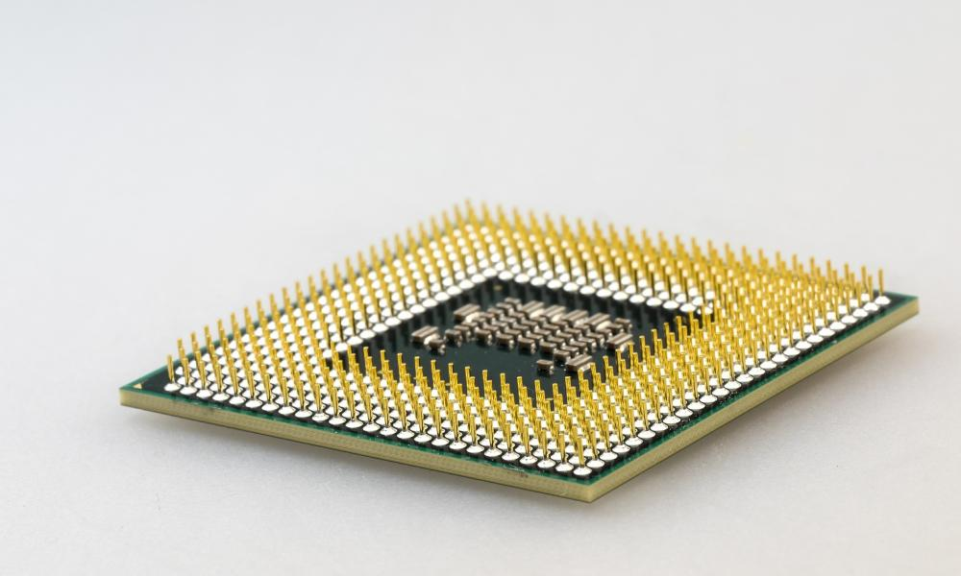
3 Main Hardware Device
Notes:
CPU: Runs the entire computer. The brain.
Primary Memory: Short term but fast memory
Secondary Memory: Slow but persistent
Explain what they do and how they work together - caches, start with secondary memory, then ram, then CPU is the orchestrator

Slide 7
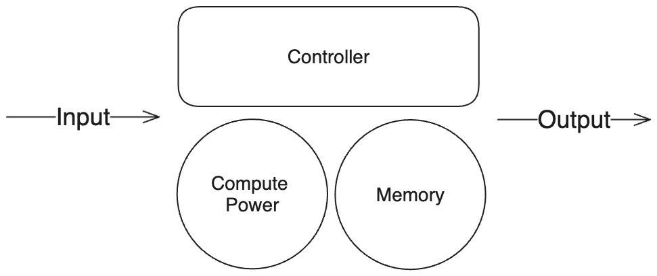
Basic Computer Operation
Notes:
If you are interested in a more hardware accurate model, see Von Neumann Architecture

Slide 8
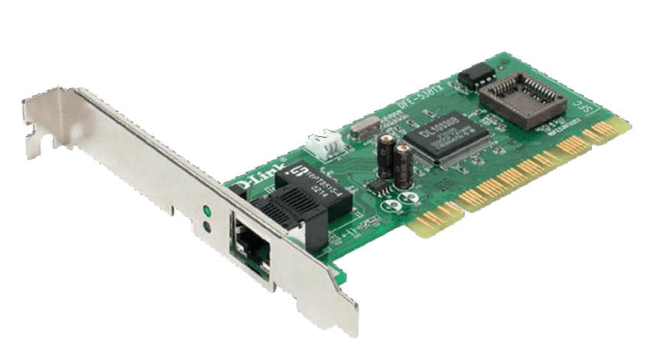
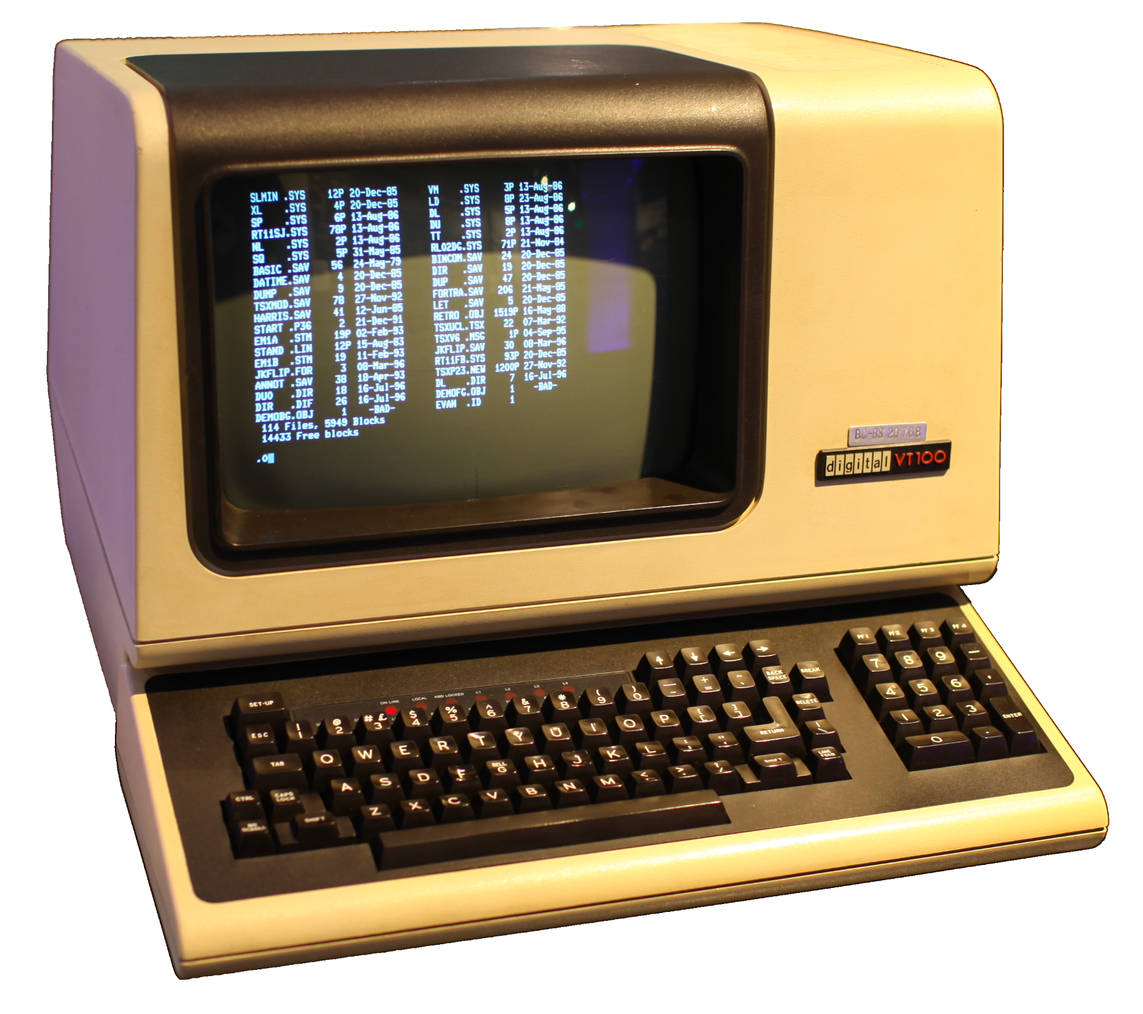
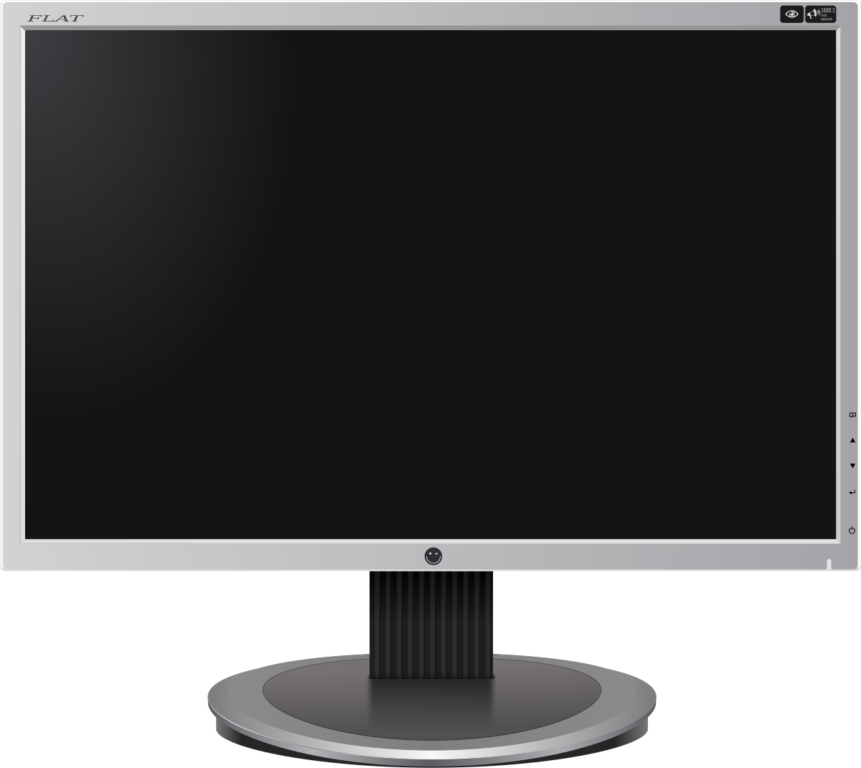
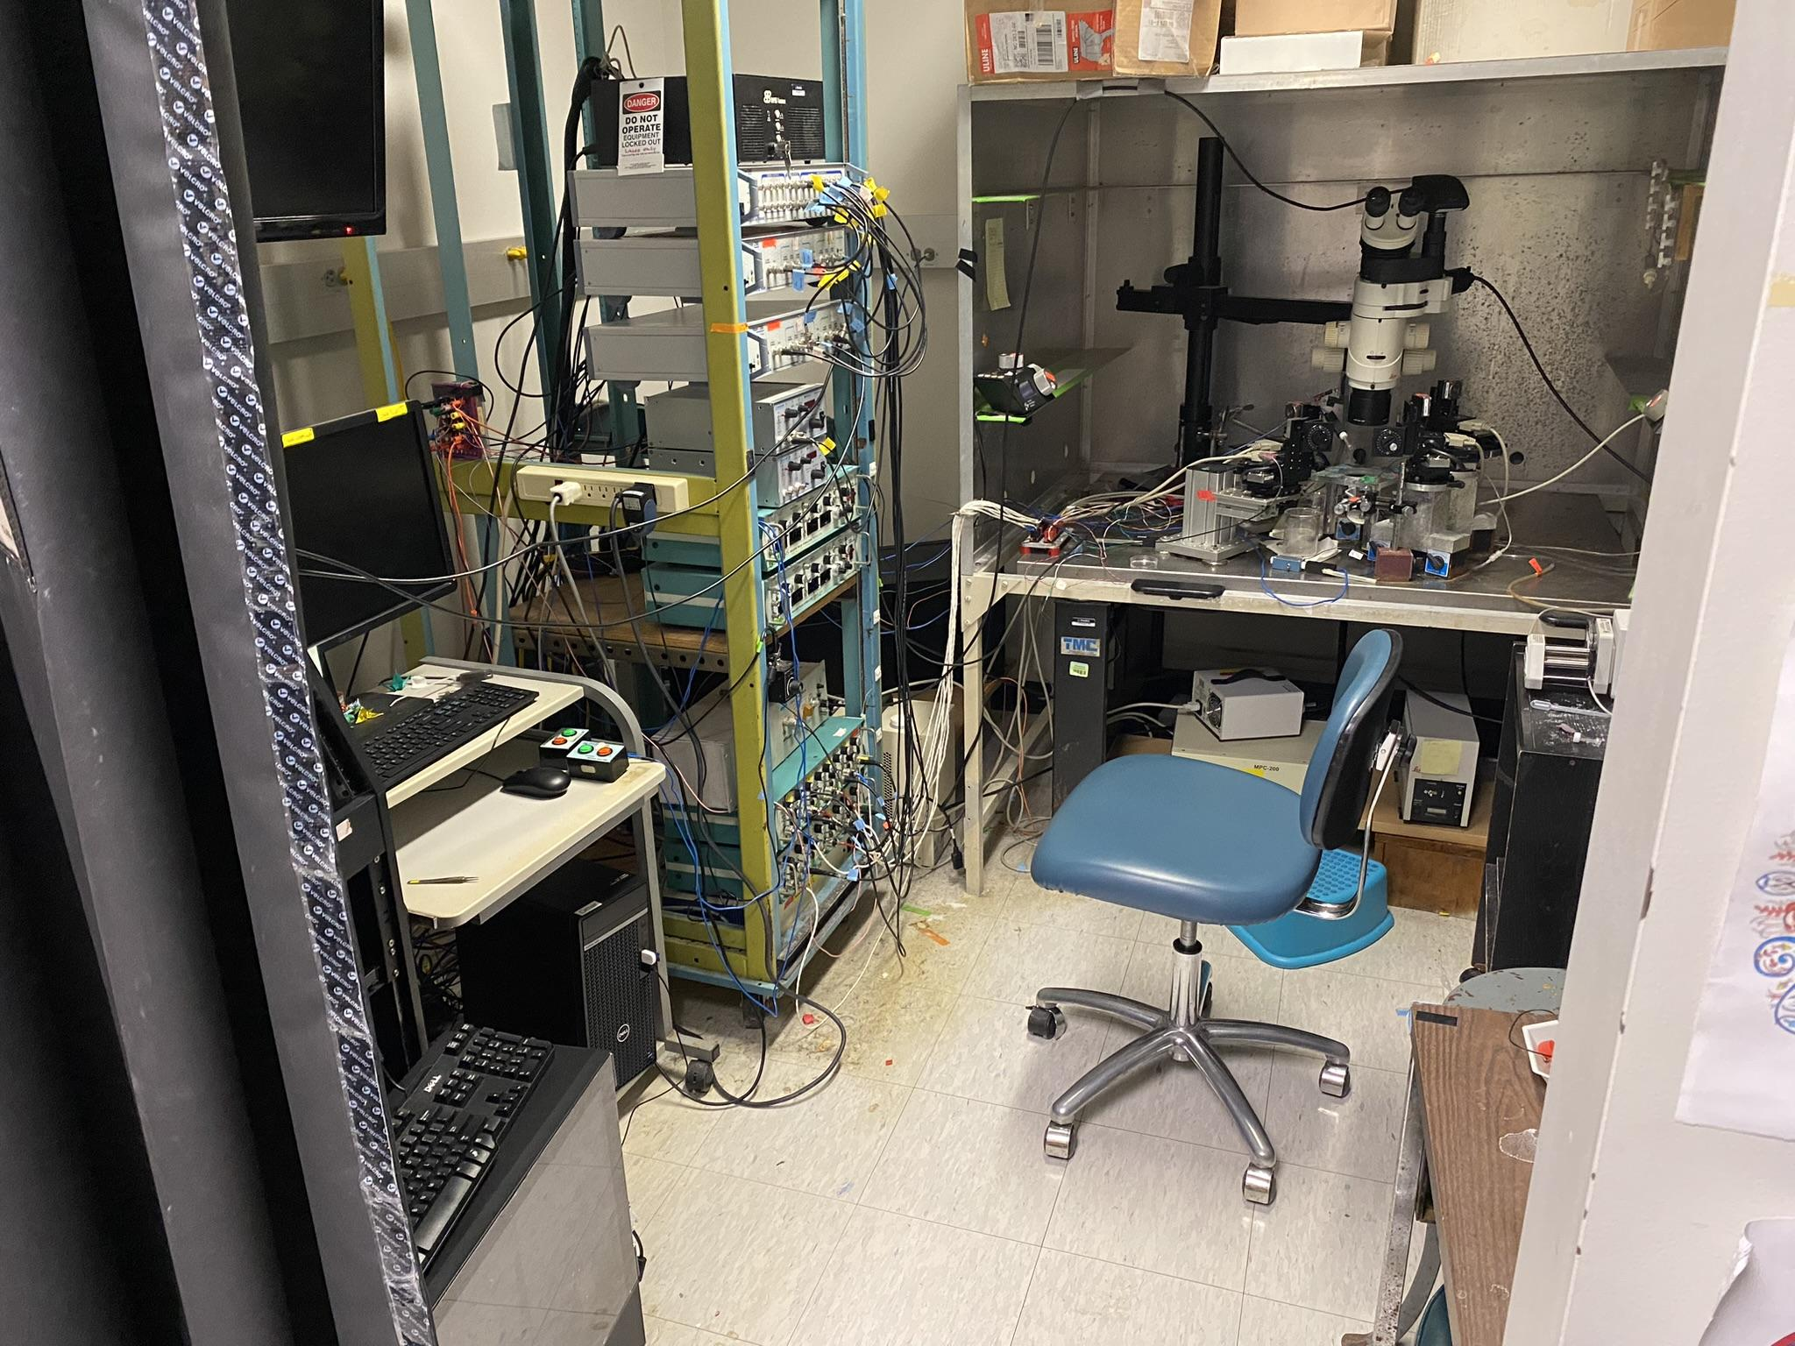
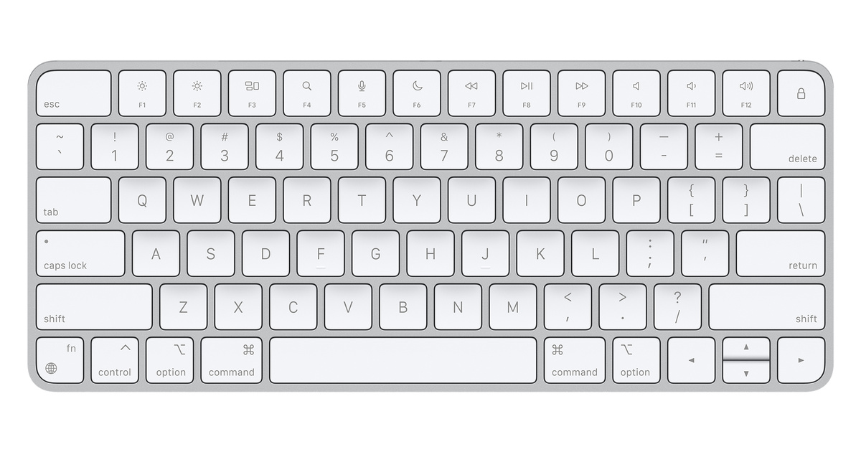
IO Devices to Impact the World
Network Interface Card
Terminal
Dynamic Clamp

Slide 9
CPU
Controller of all components
Fetch Decode Execute Cycle

Slide 10
Main Memory
Working Memory of CPU
Volatile
Pretty Fast
Used for execution of programs by CPU

Slide 11
Secondary Memory
Non Volatile
Slow
Used for storage

Slide 12
Putting Things Together
CPU and Main Memory Operate as brain
Everything else connected to CPU via “Bus” - Essentially a wire
Notes:
How can we write and execute code on this hardware?

Slide 13
The Operating System

Slide 14
The Operating System
A program that sits on top of the hardware

Slide 15
OS Abstractions
Processes
File System (Disk Memory - SSD, HDD)
Inter Process Communication
Hardware IO
And more!
We will be interacting with the OS through processes (running programs)

Slide 16
Processes
A running program
DEMO: pstree and htop command
Notes:
Looking at the running processes can give a good look at what is happening under the hood
OS switches between running processes
Processes can create other processes
On startup, there is one process that starts all other processes (your init system)
Processes can interact with the OS, and as such the hardware using system calls

Slide 17
System Calls
Functions in the OS code, invoked using special assembly instructions
There are many system calls, and they all depend on your operating system
Linux + MacOS Syscalls
Windows Syscalls
This is where power comes from!

Slide 18
Manpages
man command
hier
syscall
Environ
man
<command>

Slide 19
Discovering Linux
Knowing Linux is critical to being a good developer. Let's get to know what is has to offer and what programs are running on it!
htop
ps aux
top
Notes:
I can’t teach everything, and its your job as developers to be self sufficient - How to read documentation

Slide 20
Expected Takeaways
CPU, Main Memory and Secondary Memory
Operating System
File System
Processes
Isolated
Execution of programs / Assembly language
Can call system calls
Can create other processes
Scheduled
Location in File System
System Calls
Using manpages

